Slide 1
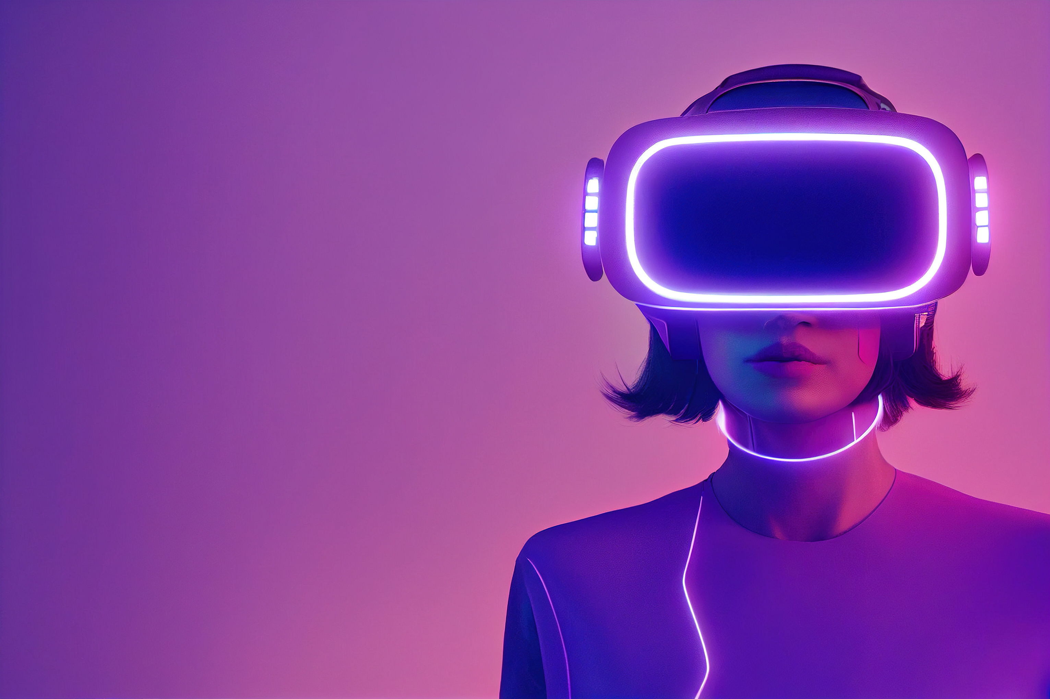

FINAL PROJECT
TNSDC -
GENERATIVE AI FOR
ENGINEERING
Presented by
Shwetha C

Slide 2

Project Title
VOICE BASED - LANGUAGE TRANSLATION

Slide 3
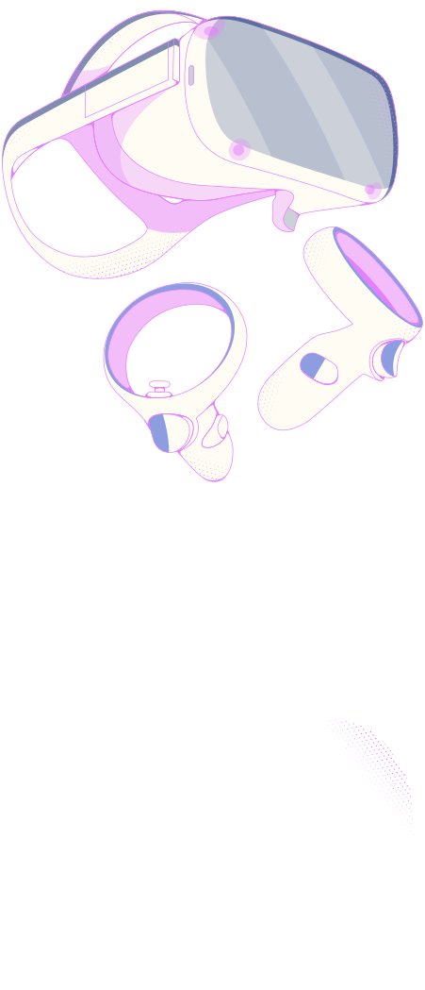

agenda
1
5
Problem Statement
Solution
2
6
Project Overview
Modelling
3
7
End Users
Results
4
Value Proposition

Slide 4
Problem Statement
In a world increasingly connected yet linguistically diverse, the ability to communicate across language barriers is more crucial than ever. Individuals seeking to learn new languages, travelers navigating foreign lands, and global businesses are often hindered by these barriers. Traditional translation methods can be slow and lack the nuance of native speech, creating a demand for real-time, accurate, and context-aware translation solutions.
Let’s begin!

Slide 5
Project Overview
This project presents an innovative language translation system designed to bridge the gap between diverse languages through speech recognition and audio output. Leveraging advanced libraries such as SpeechRecognition, deep-translator, gtts (Google Text-to-Speech), and pygame for audio playback, this system offers a seamless way to translate spoken language into a target language, in this case, Tamil, and then audibly present the translation to the user.

Slide 6

End Users
The primary users of this language translator are:
Language Learners: Individuals looking to practice and improve their understanding of foreign languages.
Travelers: People visiting countries where they do not speak the local language.
International Businesses: Companies that operate globally and require real-time translation to improve communication with clients and partners.
Educational Institutions: Schools and universities that aim to provide language learning tools to students

Slide 7
This language translation system offers several key benefits:
Accessibility: Breaks down language barriers, making communication accessible to everyone, regardless of linguistic background.
Efficiency: Offers real-time translation, significantly speeding up cross-linguistic communication.
Portability: As a software solution, it can be easily deployed on various devices, making it a versatile tool for users on the go.
Ease of Use: With a simple user interface that requires only voice input, it is accessible even to users who are not technologically savvy.
Value Propositions

Slide 8

Solution
The solution integrates several powerful Python libraries to create a workflow that captures speech, translates it into the target language (Tamil), and converts the translated text back into speech. Here's a brief overview of the process:
Speech Recognition: The system uses the SpeechRecognition library to convert spoken words into text.
Translation: The deep-translator library translates the recognized speech text into Tamil.
Text-to-Speech: The gtts library converts the translated text into audible speech.
Audio Playback: pygame is used for playing back the translated audio, making it easy for the user to hear the translation.

Slide 9
Modelling
This project doesn't use traditional modeling since it's an application-focused solution leveraging existing libraries and APIs. The "model" in this context is the integrated workflow that processes user input (speech) and produces an audible translation. The choice of libraries ensures the system is using state-of-the-art algorithms for speech recognition, translation, and text-to-speech synthesis.

Slide 10
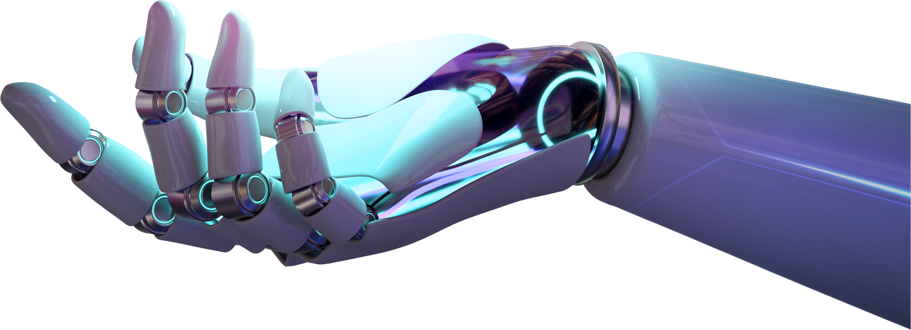
RESULT
The result is a practical and user-friendly language translation tool that can accurately translate spoken language into Tamil and then audibly present the translation. This tool facilitates immediate and natural communication across language barriers, offering a significant advantage in learning, travel, and international business contexts.

Slide 11
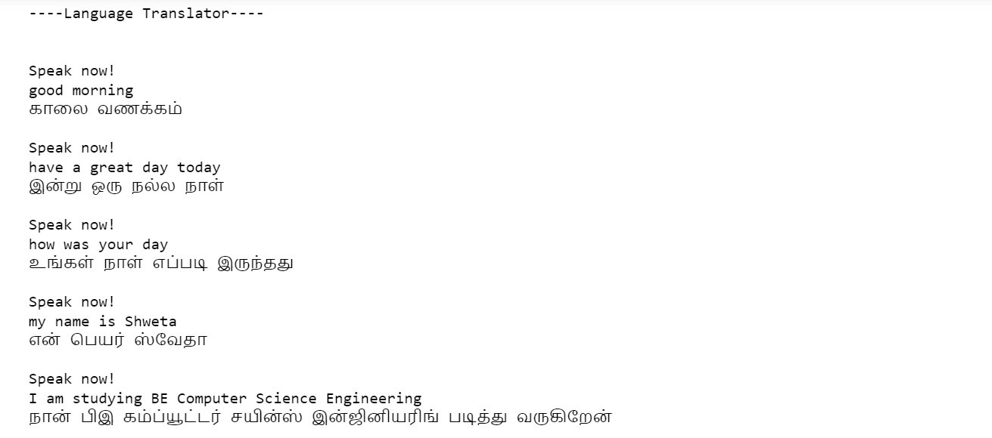
OUTPUT

Slide 12
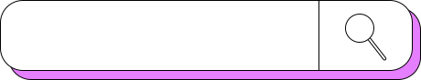
Thank
you!
PROJECT GITHUB LINK

